Slide 1
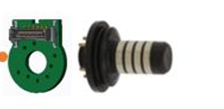
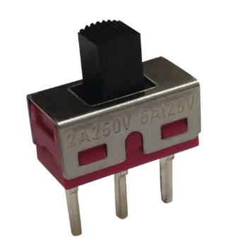
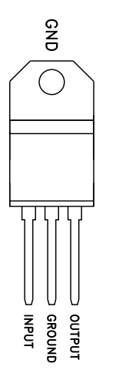
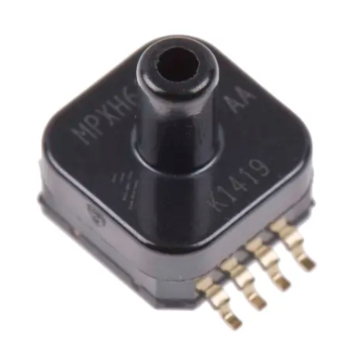
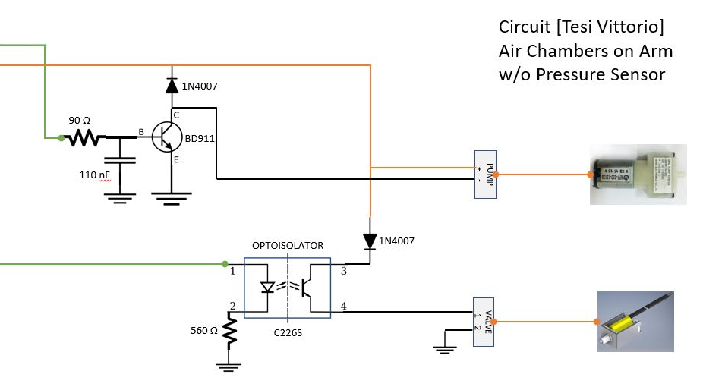
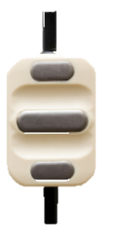
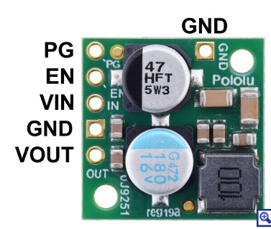
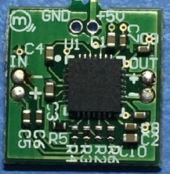
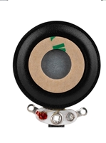
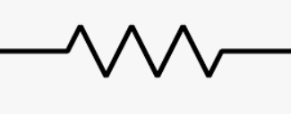
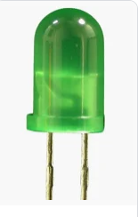
12 V battery
12V
L78
GND
5 V
12V
5 V
GND
3V3
0.33 uF
0.1 uF
GND
12V
GND
ERNI
GND
MasterMode switch
JST
Pressure sensor
3V3
Air valve
5 V
RS485 -
Air pump
RS485 +
GND
Logic To Power
Logic Board
12V
GND
3V3
GND
5 V
VT_2+
VT_2-
VT_1-
JST
ERNI
ERNI
ERNI
VT_1+
ADC
Additional GPIO
JST
1K

Slide 2
Power Supply
1 | Battery 12 V
1 | Voltage Regulator 12→ 5V (L7805CV) | https://mou.sr/44wnume
1 | Capacitor 0.33 uF
1 | Capacitor 0.1 uF
1 | Voltage Regulator 12→ 3.3V (D24V22F3) | https://www.pololu.com/product/2857
Vibrotactile
2 | Audio Amplifiers (Mini-Haptuamp) | https://tactilelabs.com/products/mini-haptuamp/
2 | Sound exciters (check Zout compatibility with amplifier) (DAEX13CT-4 ) | https://www.daytonaudio.com/product/1172/daex13ct-4-coin-type-13mm-exciter-3w-4-ohm
Air chamber
1 | Optoisolator C226S | https://mou.sr/3QxHXBm
1 | Resistor 560 ohm
2 | Diodes 1N4007 | https://mou.sr/3UQq6YT
1 | Transistor BD911 | https://mou.sr/3ydirer
1 | Resistor 90 ohm
1 | Capacitor 110 nF
1 | 5V Air Pump | https://us.rs-online.com/product/rs-pro/7026898/70647434/
1 | 3.3V Air Valve
1 | Pressure sensor (MPXH6400AC6U) | https://mou.sr/4dxhYUE
2 | Silicon air chambers
1 | Silicon tube for air flow
2 | Tube joints
General
1 | Logic Board
1 | Switch SPDT | https://uk.rs-online.com/web/p/slide-switches/7347334
1 | LED
1 | Resistor 1kohm
2 | sEMG electrodes (13E200 Ottobock) | https://shop.ottobock.us/c/Electrode/p/13E200~550
1 | Jst → EMG adapter
2 | Jst → ERNI_10pins adapter
1 | Jst → microUSB adapter
3 | ERNi male port | https://it.rs-online.com/web/p/strip-e-connettori-pcb/0247616?gb=s
 | Matrix boards for prototyping | https://it.rs-online.com/web/p/schede-a-matrice/1596322?cm_mmc=IT-PLA-DS3A-_-google-_-CSS_IT_IT_ePMax_high-_--_-1596322&matchtype=&&gad_source=1&gclid=Cj0KCQjwxeyxBhC7ARIsAC7dS3-f15lH__SCWnDj-Y84NC73Bas111zslvWFvuxUNG1JMpuK-fii24AaAuzqEALw_wcB&gclsrc=aw.ds
 | PCB connectors | https://mou.sr/3UP7Uie
 | cables

